Slide 1

Department of Information Technology
A.P. Shah Institute of Technology
G.B.Road,Kasarvadavli, Thane(W), Mumbai-400615
UNIVERSITY OF MUMBAI
Academic Year 2019-2020

Slide 2
A Project Report on
Autonetics and Administration for IT Laboratories
Submitted in partial fulfillment of the degree of
Bachelor of Engineering(Sem-7)
in
INFORMATION TECHNOLOGY
By
Uddhabendra Maity (16104062)
Karthikeyan (16104050)
Atharv Shetty (16104061)
Under the Guidance of
Dr. Sameer Nanivadekar Prof. Vishal Badgujar

Slide 3
1.Project Conception and Initiation

Slide 4
Introduction
In our system, we try to eradicate the problem regarding the administration of labs. A powerful, systematical and efficient Lab management system is required which will resolve all these basic and generic problems with less human labor. The basic technology that we implemented in our system is Ansible.
Ansible is used to automate the administration of labs. Here every lab will have its separate playbook. In that playbook a certain set of rules will be written and accordingly the automation of the labs will be done.
Ansible is a simple open source IT engine which automates application deployment, cloud provisioning and many other IT tools.
Ansible uses playbook to describe automation jobs, and playbook uses very simple language i.e. YAML (It’s a human-readable language & is commonly used for configuration files) which is very easy for humans to understand, read and write.

Slide 5
1.1 Abstract
Often it is observed that many of the PC's are remained switched on even when the labs are not in use resulting in an inefficient use of power and resources. Also the PCs have to be manually switched off by the lab assistants after the end of lab sessions if the students haven't shut it down themselves.
In some lab sessions, a particular software or simulation tool (eg. NS2 simulator, rapidminer) has to be installed in each and every PC in the lab at the same time which results in a great amount of time wastage and also pushes the centralized server to its limits.A powerful,systematical and efficient Lab management system is required which will resolve all these basic and generic problems with less human labor. In our case, the Ansible tool which was developed to simplify complex orchestration and configuration management tasks has been chosen.

Slide 6
1.2 Objectives
To Automate the Software installation process
To Automate the PC shutdowns
To regulate the user identity of every PC along with time in a digital format
To alert the users about the remaining time of the current lab session
A proper GUI will be created which will display the important announcements
To unleash the full potential of Ansible for IT automation

Slide 7
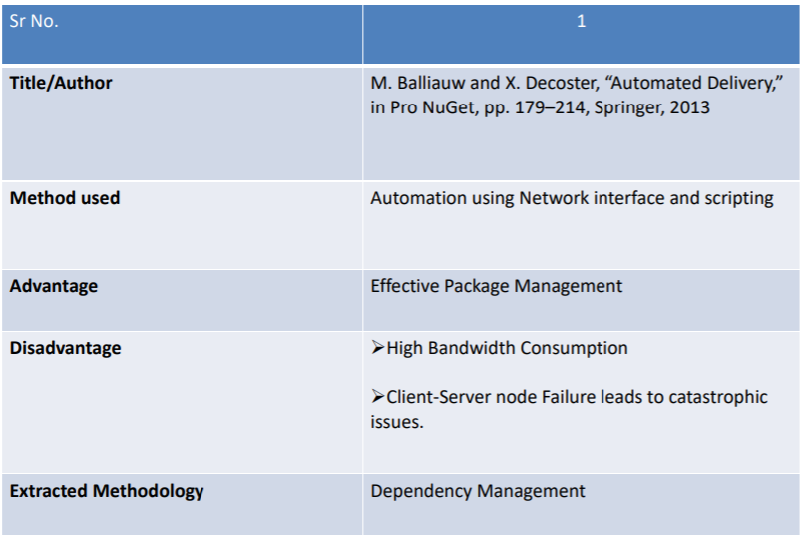
1.3 Literature Review

Slide 8
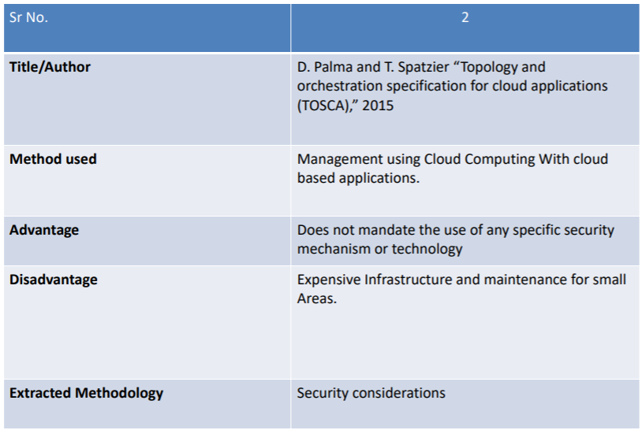

Slide 9
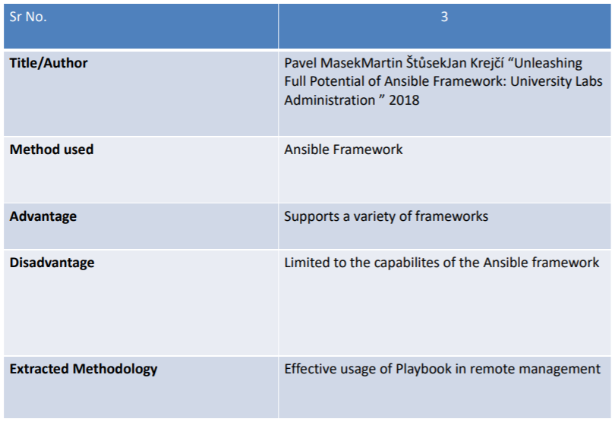

Slide 10
1.4 Problem Definition
In current labs of university most of the administrative work is done manually which consumes lot of time and efforts.
With the help of Ansible framework and a proper supporting GUI which can unleash and maximize the full potential of the servers, many of the current lab administrative problems can be resolved.

Slide 11
1.5 Scope
The proposed system will be helpful for modernizing the current lab scenarios in the universities.
This is completely an open source project and thus the total outcome expenditure is very low. Due to this, even the universities in the rural areas can claim benefit out of this.
The GUI will have a tutorial at the beginning for the lab handlers.
The project can be easily developed further as per the requirements of the lab

Slide 12
1.6 Technology stack
Hosting : Ansible Web Server
Nodes : Linux, Ubuntu,Windows
Database : MySQL
Front End : Python, HTML5 , Semaphore

Slide 13
1.7 Benefits for environment & Society
Simplified GUI will allow powerful and customized remote node management.
Reduced workload since Ansible works on a Centralized environment.
Remote nodes can be shut down by the Administrator with ease, thereby cutting unwanted electricity usage by a system in idle state.
Secure remote management and file transfer as Ansible uses SSH protocol for its operations.

Slide 14
2. Project Design

Slide 15
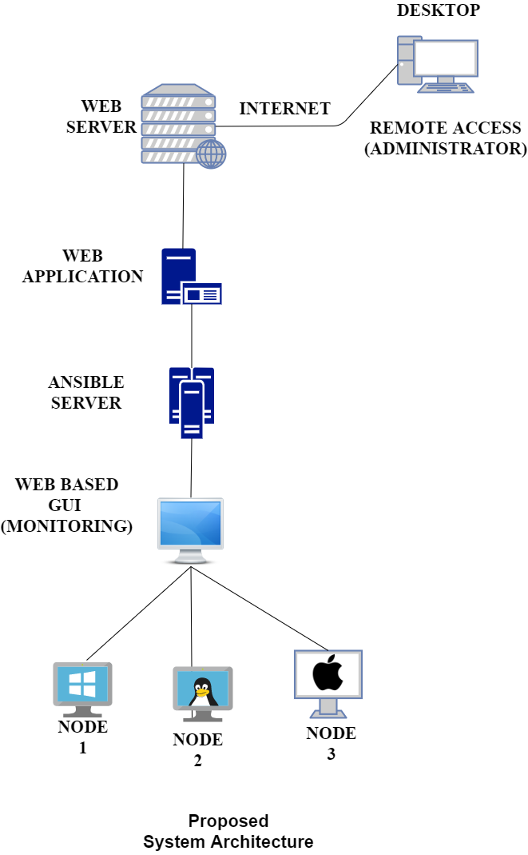
2.1 Proposed System

Slide 16
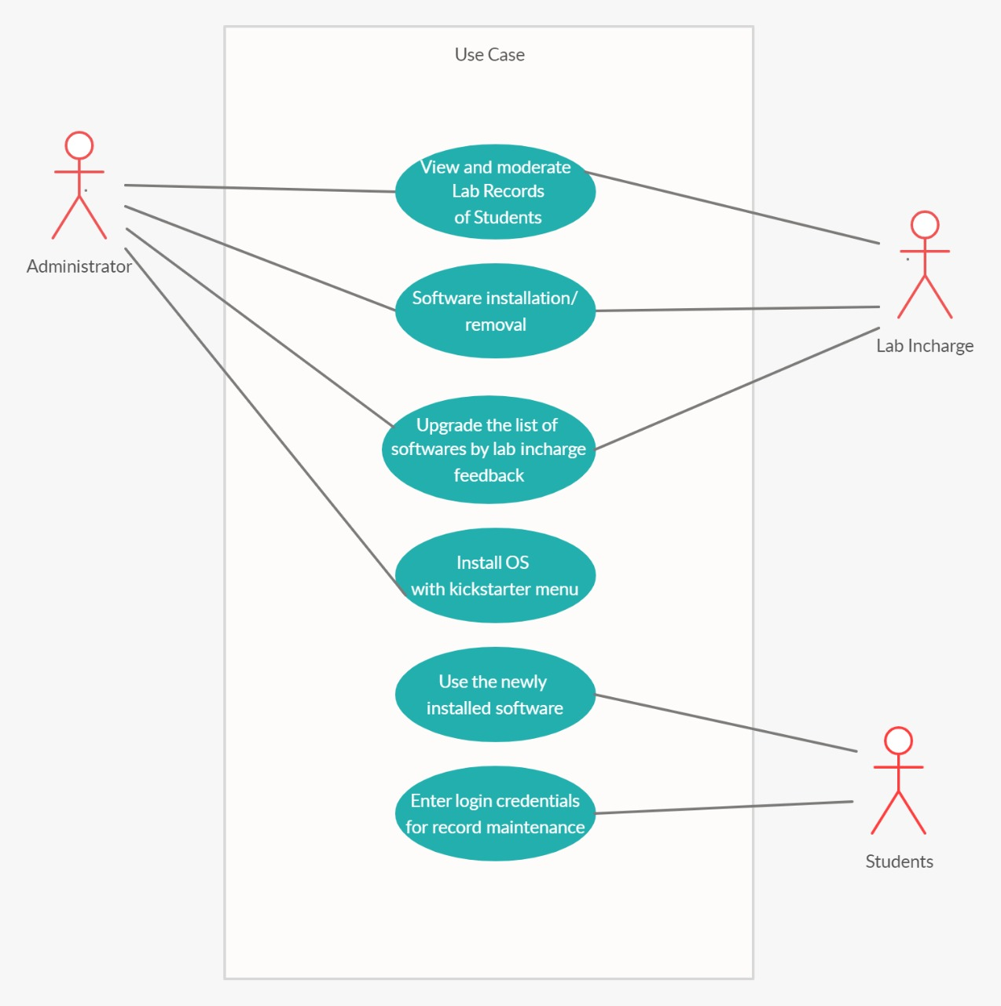
2.2 Design(Flow Of Modules)

Slide 17
2.3 Description Of Use Case
Students need to enter their details on the Lab Utilization Webpage after which they can use the installed softwares.
Lab incharge personnel can view lab utilization records, remotely shut down the system as well as manage softwares installed on their respective labs. They cannot view lab utilization records, remotely shut down the system or modify software packages of systems which do not belong to their allotted lab.
Administrators can view lab utilization records, remotely shut down the systems as well as manage software packages installed of any system of any lab. Administrator can perform remote OS installation with Kickstarter along with preset parameters like Disk partitions, Networking configurations etc

Slide 18
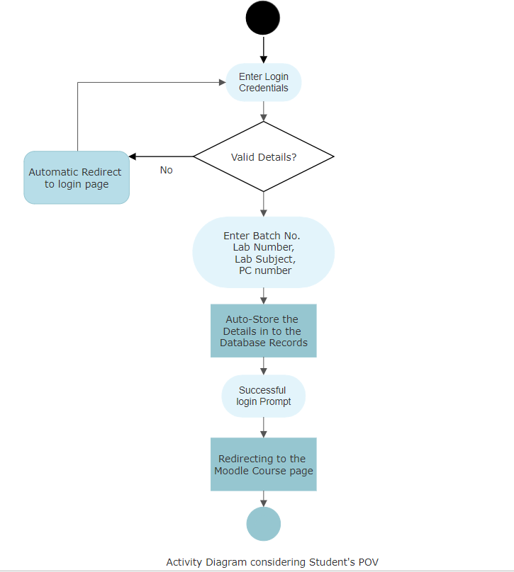
2.4 Activity diagram

Slide 19
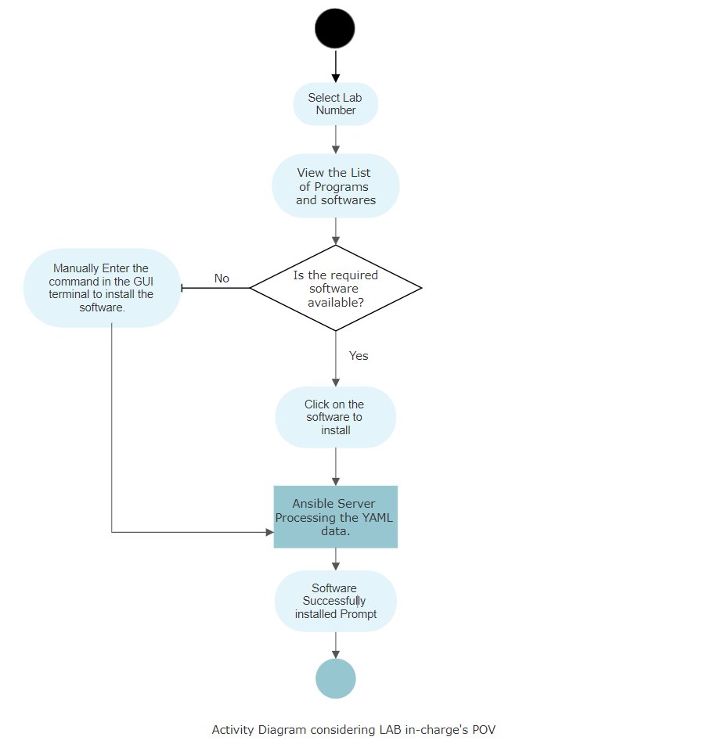

Slide 20
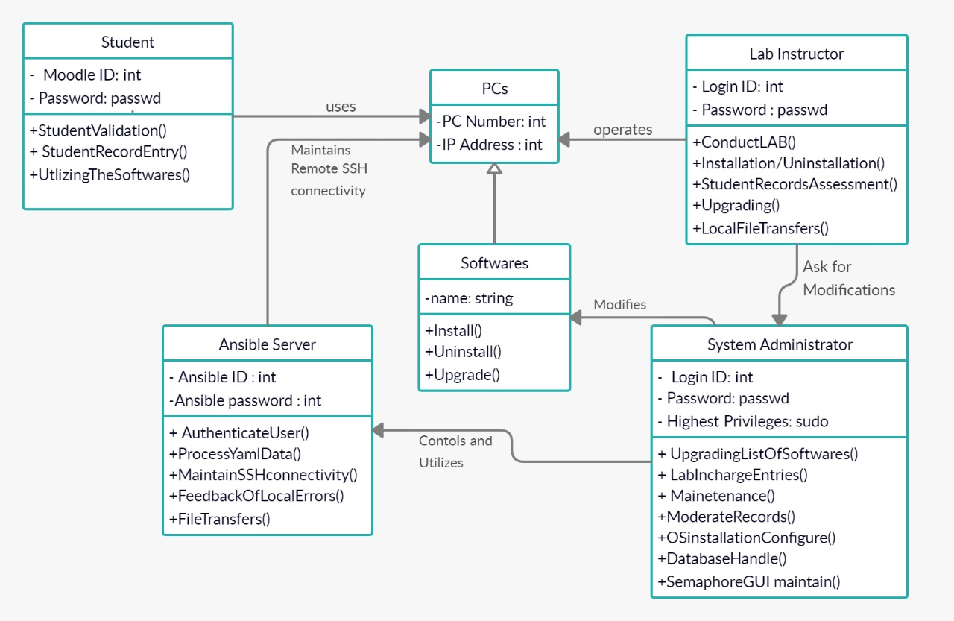
2.5 Class Diagram

Slide 21
2.6 Module-1 Ansible Server
Ansible server will be used for hosting the Ansible environment through the whole network via the LAN connection and thus all ansible related queries and commands for lab automation can be easily carried throughout.
Operations which will be performed through Ansible server are:-
Remote software installation/uninstallation
Remote system shutdown
Remote file transfer
Running Ansible Module commands.
Running remote terminal/shell commands

Slide 22
2.6 Module-2 Online Lab Utilization Record Module
The students will be prompted to enter their details in this website like :-
User ID
Password
Batch
Subject
Lab No.
All these informations would be stored in a database which can then be examined by respective
Lab incharges and Admins.

Slide 23
Module-3 Kickstarter
OS installation takes a lot of time. We are automating this task by integrating an open source tool into our system called as Kickstarter.
This will not only help in installing operating systems on multiple systems remotely, but also make the required configurations such as disk management, network configurations, etc.

Slide 24
Module-4 Semaphore
Ansible Semaphore is an Open Source UI for Ansible, an alternative to Ansible Tower. The software is free to use and fully open source, released under MIT license.
The backend of Semaphore is written in Go while the frontend is written in Angular. This tool allows you to launch Ansible Tasks from a Web interface. It has support for LDAP authentication, provides RESTful API and alerting via email and Telegram.

Slide 25
2.7 References
[1] Pavel MasekMartin ŠtůsekJan Krejčí, “Unleashing Full Potential of Ansible Framework: University Labs Administration” May 2018
[2] Nishant Kumar Singh ,Amity University,”Automated Provisioning of Application” June 2017
[3] J. O. Benson, J. J. Prevost, and P. Rad, “Survey of automated software deployment for computational and engineering research,” in System Conference (SysCon), 2016 Annual IEEE, pp. 1–6, IEEE, 2016.

Slide 26
Planning
GUI for Ansible scripts using Semaphore
Windows OS node remote management using Ansible-WRM
Kickstart dual boot with Ansible
Local hosting of Lab Utilization webpage

Slide 27
Thank You

